Slide 1
AZ-104T00A Administer Monitoring

Slide 2



Administer Monitoring Introduction
Configure Azure Monitor
Configure Azure Alerts
Configure Log Analytics
Lab 11 – Implement Monitoring
Notes:
Module overview – Network Watcher has moved to Traffic Management in networking.

Slide 3
Configure Azure Monitor

Slide 4




Configure Azure Monitor Introduction
Describe Azure Monitor Key Capabilities
Describe Azure Monitor Components
Define Metrics and Logs
Identify Data Types
Describe Activity Log Events
Query the Activity Log
Summary and Resources
Notes:
Monitor and back up Azure resources (10-15%)
Monitor resources by using Azure Monitor
Configure and interpret metrics
Configure Log Analytics
Query and analyze logs
Set up alerts and actions
Configure Application Insights

Slide 5
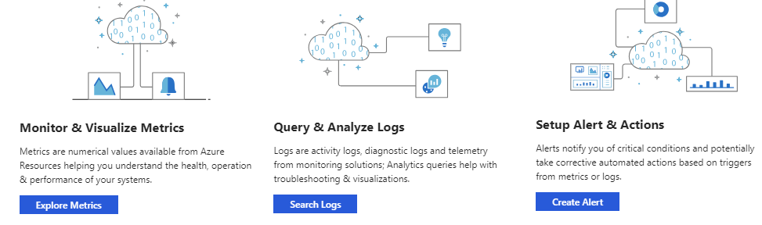
Describe Azure Monitor Key Capabilities
Core monitoring for Azure services
Collects metrics, activity logs, and diagnostic logs
Use for time critical alerts and notifications

Slide 6
Understand Azure Monitor Components
Notes:
What is Azure Monitor - https://docs.microsoft.com/azure/azure-monitor/overview

Slide 7
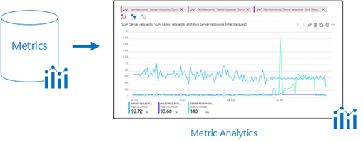
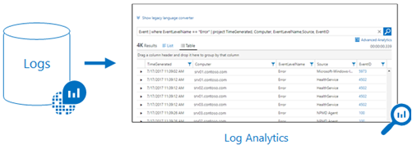
Define Metrics and Logs
Metrics are numerical values that describe some aspect of a system at a point in time
They are lightweight and capable of supporting near real-time scenarios
Logs contain different kinds of data organized into records with different sets of properties for each type
Telemetry (events, traces) and performance data can be combined for analysis
Notes:
For your use there are 3 additional slides at the end of the presentation.
Metrics - https://docs.microsoft.com/azure/azure-monitor/platform/data-platform-metrics
Logs - https://docs.microsoft.com/azure/azure-monitor/platform/data-platform-logs

Slide 8



Identify Data Types
Application monitoring data – Performance and functionality of the code you have written, regardless of its platform
Guest OS monitoring – Azure, another cloud, or on-premises
Azure resource monitoring
Azure subscription monitoring – Operation and management of an Azure subscription, as well as data about the health and operation of Azure itself
Azure tenant monitoring – Operation of tenant-level Azure services, such as Azure Active Directory
Notes:
Sources of monitoring data for Azure Monitor - https://docs.microsoft.com/azure/azure-monitor/platform/data-sources

Slide 9
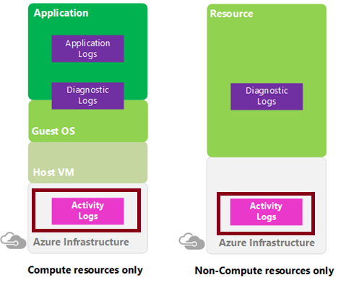
Describe Activity Log Events
Send data to Log Analytics for advanced search and alerts
Query or manage events in the Portal, PowerShell, CLI, and REST API
Stream information to Event Hub
Archive data to a storage account
Analyze data with Power BI
Notes:
Azure Activity log - https://docs.microsoft.com/azure/azure-monitor/platform/activity-log
Send Azure Activity log to Log Analytics workspace using Azure portal - https://docs.microsoft.com/azure/azure-monitor/learn/quick-collect-activity-log-portal

Slide 10
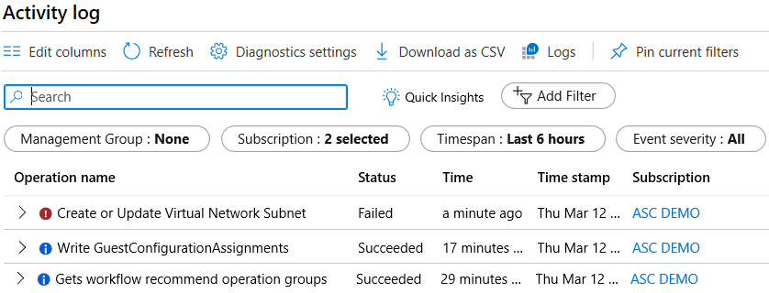
Query the Activity Log
Filter by Management group, Subscription, Timespan, and Event Severity
Add a filter, like Event Category (Security, Recommendations, Alerts)
Pin current filters and download as CSV
Notes:
Query the Activity Log in the Azure portal - https://docs.microsoft.com/azure/monitoring-and-diagnostics/monitoring-overview-activity-logs#query-the-activity-log-in-the-azure-portal

Slide 11
Summary and Resources – Configure Azure Monitor
Knowledge Check Questions
Microsoft Learn Modules (docs.microsoft.com/Learn)
Monitor, diagnose, and troubleshoot your Azure storage (Sandbox)
Analyze your Azure infrastructure by using Azure Monitor logs (Sandbox)
Monitor and report on security events in Azure AD Docs
Monitor the performance of virtual machines using Azure Monitor VM Insights (Sandbox)
A sandbox indicates a hands-on exercise.
Notes:
https://docs.microsoft.com/learn/
The Assessment Guide in the MCT DLC has open-ended questions.
Name at least three data sources that can be used by Azure Monitor.
Answer: Azure Monitor can ingest many different data sources. Sources include application code, operating system, resource, subscription, and tenant data. You can even create your own custom data source. Data sources generally fall into two categories metrics and logs. Metrics are numerical values that describe some aspect of a system at a point in time. For example, virtual machine CPU performance. Logs contain data organized into records with different sets of properties for each type. For example, the activity log shows subscription-level events. This includes such information as when a resource is modified or when a virtual machine is started.

Slide 12
Configure Azure Alerts

Slide 13

Configure Azure Alerts Overview
Manage Azure Monitor Alerts
Create Alert Rules
Create Action Groups
Demonstration – Alerts
Summary and Resources
Notes:
Monitor and back up Azure resources (10-15%)
Monitor resources by using Azure Monitor
Configure and interpret metrics
Configure Log Analytics
Query and analyze logs
Set up alerts and actions
Configure Application Insights

Slide 14
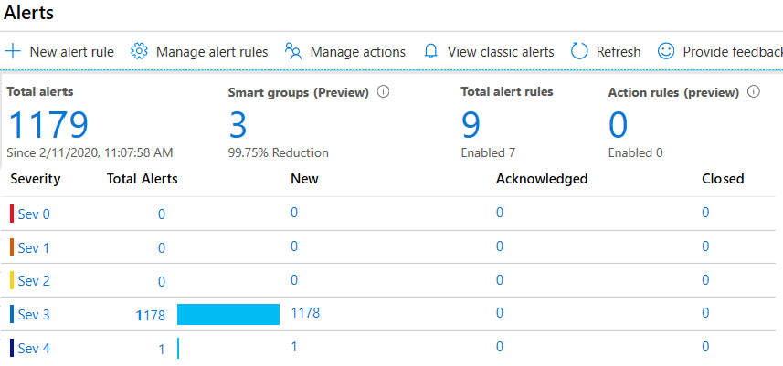
Manage Azure Monitor Alerts
Unified authoring experience
Displayed by severity
Categorized by New, Acknowledged, and Closed
Notes:
The new alerts experience in Azure Monitor - https://docs.microsoft.com/azure/monitoring-and-diagnostics/monitoring-overview-unified-alerts

Slide 15
Create Alert Rules
Scope: Target selection, Alert criteria, and Alert logic
Alert rule details: name, description, and severity (0 to 4)
Action group: Notify your team via email and text messages or automate actions using webhooks and runbooks
Notes:
Respond to events with Azure Monitor Alerts - https://docs.microsoft.com/azure/azure-monitor/learn/tutorial-response
Create, view, and manage metric alerts using Azure Monitor - https://docs.microsoft.com/azure/azure-monitor/platform/alerts-metric

Slide 16
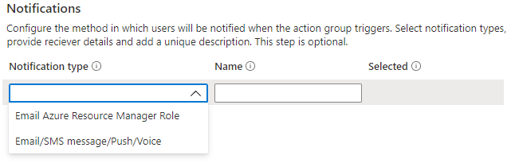
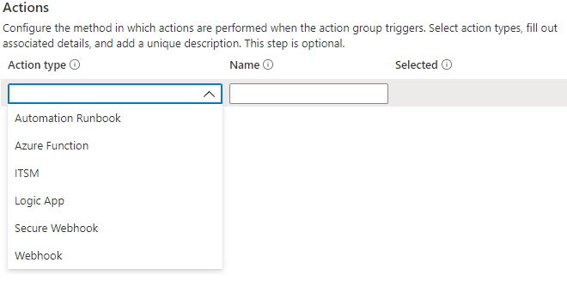
Create Action Groups
Configure the method in which users will be notified when the action group triggers
Configure the method in which actions are performed when the action group triggers
Notes:
Create and manage action groups in the Azure portal - https://docs.microsoft.com/azure/azure-monitor/platform/action-groups

Slide 17
Demonstration – Alerts
Create an alert rule
Explore alert targets
Explore alert conditions
Explore alert details
Notes:
✔ Always consider having students walk-through the demonstrations themselves. Also, consider the overlap with the formal labs and your best use of time.

Slide 18
Summary and Resources – Configure Azure Alerts
Knowledge Check Questions
Microsoft Learn Modules (docs.microsoft.com/Learn)
Improve incident response with alerting on Azure (Sandbox)
Configure for alerts and detections in Microsoft Defender for Endpoint
Manage alerts and incidents in Microsoft Defender for Endpoint
Remediate security alerts using Microsoft Defender for Cloud
A sandbox indicates a hands-on exercise.
Notes:
https://docs.microsoft.com/learn/
The Assessment Guide in the MCT DLC has open-ended questions.
You need to configure several Azure alerts. How will you assign/notify the help desk personnel when an alert is triggered? What methods can be used to notify them?
Answer: The help desk personnel should be added to an action group. An action group is a collection of notification preferences. Alerts use action groups to notify users that an alert has been triggered. Various alerts may use the same action group or different action groups depending on the user's requirements. Notification methods include push notifications to the Azure mobile app, email, SMS, and voice.
You are reviewing the Azure Monitor alerts page. What alert states (statuses) are possible?
Answer: There are three alert states New, Acknowledged, and Closed. New indicates an issue has been detected and hasn’t been reviewed. Acknowledged indicates an administrator has reviewed the alert and started working on it. Closed indicates the issue has been resolved. You can reopen a closed alert if the issue returns.

Slide 19
Configure Log Analytics

Slide 20

Configure Log Analytics Introduction
Determine Log Analytics Uses
Create a Workspace
Query Log Analytics Data
Structure Log Analytics Queries
Demonstration – Log Analytics
Summary and Resources
Notes:
Monitor and back up Azure resources (10-15%)
Monitor resources by using Azure Monitor
Configure and interpret metrics
Configure Log Analytics
Query and analyze logs
Set up alerts and actions
Configure Application Insights

Slide 21
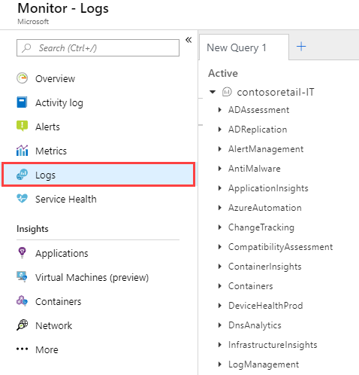
Determine Log Analytics Uses
A service that helps you collect and analyze data generated by resources in your cloud and on-premises environments
Write log queries and interactively analyze their results
Examples include assessing system updates and troubleshooting operational incidents
Notes:
Overview of Azure Monitor agents - https://docs.microsoft.com/azure/azure-monitor/platform/agents-overview

Slide 22
Create a Workspace
A workspace is an Azure resource and is a container where data is collected, aggregated, analyzed, and presented
You can have multiple workspaces per Azure subscription, and you can have access to more than one workspace
A workspace provides a geographic location, data isolation, and scope
Notes:
Create a Log Analytics workspace in the Azure portal -https://docs.microsoft.com/azure/azure-monitor/learn/quick-create-workspace

Slide 23
Query Log Analytics Data
Common queries and a query language for custom searches
Quickly retrieve and consolidate data in the repository
Save or have log searches run automatically to create an alert
Export the data to Power BI or Excel
Notes:
Overview of log queries in Azure Monitor - https://docs.microsoft.com/azure/azure-monitor/log-query/log-query-overview
Get started with log queries in Azure Monitor - https://docs.microsoft.com/azure/azure-monitor/log-query/get-started-queries

Slide 24
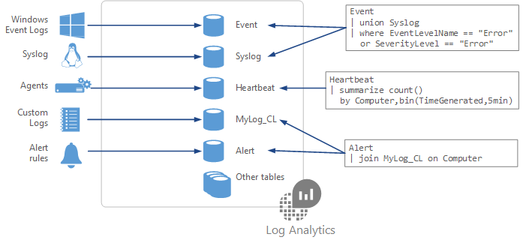
Structure Log Analytics Queries
Event
| where (EventLevelName == "Error")
| where (TimeGenerated > ago(1days))
| summarize ErrorCount = count() by Computer
| top 10 by ErrorCount desc
Notes:
Azure Monitor log queries - https://docs.microsoft.com/azure/azure-monitor/log-query/query-language
Azure Monitor log query examples - https://docs.microsoft.com/azure/azure-monitor/log-query/examples

Slide 25
Demonstration – Log Analytics
Access the demonstration environment
Use the Query Explorer
Notes:
✔ Always consider having students walk-through the demonstrations themselves. Also, consider the overlap with the formal labs and your best use of time.

Slide 26
Summary and Resources – Configure Log Analytics
Knowledge Check Questions
Microsoft Learn Modules (docs.microsoft.com/Learn)
Analyze your Azure infrastructure by using Azure Monitor logs (Sandbox)
Monitor the performance of virtual machines using Azure Monitor VM Insights (Sandbox)
Write your first query with Kusto Query Language
A sandbox indicates a hands-on exercise.
Notes:
https://docs.microsoft.com/learn/
The Assessment Guide in the MCT DLC has open-ended questions.
You would like to structure queries against the Windows Event log. Specifically, you would like to identify any errors. What product should you use? What query language is available to construct the query?
Answer: You should use a Log Analytics workspace. The workspace can receive data from the Windows Event log. The event records can then be visualized or queried. Azure uses the Kusto query language. Windows Event logs are stored in the Event table. to query the event table for errors, use this command:
Event
| where (EventLevelName == "Error")

Slide 27
Lab 11 – Implement Monitoring

Slide 28
Lab 11 – Implement monitoring
Lab scenario
You need to evaluate Azure functionality that would provide insight into performance and configuration of Azure resources, focusing on Azure virtual machines. To accomplish this, you intend to examine the capabilities of Azure Monitor, including Log Analytics
Objectives
Task 1: Provision the lab environment
Task 2: Create and configure an Azure Log Analytics workspace and Azure Automation-based solutions
Task 3: Review default monitoring settings of Azure virtual machines
Task 4: Configure Azure virtual machine diagnostic settings
Task 5: Review Azure Monitor functionality
Task 6: Review Azure Log Analytics functionality
Next slide for an architecture diagram
Notes:
LAB 11 - Implement Monitoring - ESTIMATED DURATION 45 MIN
Lab Repository - https://microsoftlearning.github.io/AZ-104-MicrosoftAzureAdministrator/

Slide 29





Lab 11 – Architecture diagram
Task 1
az104-11-rg0
az104-11-vnet 10.0.0.0/24
Task 3
Subnet0 10.0.0.0/26
az104-11-rg0
Task 6
Task 4, Task 5
Task7
Azure Monitor
az104-11-vm0
10.0.0.4
LogAnalyticsWorkspace
New alert rule
Task 2
AutomationAccount
CloudShell
Register the Microsoft.Insights and Microsoft.AlertsManagement resource providers

Slide 30

End of presentation

Slide 31
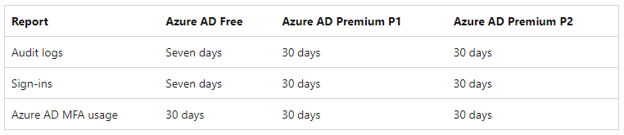
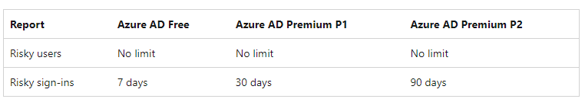
Default Azure Active Directory Logs
Activity Reports
Security Signals
Features of Azure Monitor that are automatically enabled such as collection of standard metrics and activity logs are provided at no cost.
For more functionality such as longer retention, you should route the entries to another location based on your needs.
Entries in the Activity Log are system generated and cannot be changed or deleted.
Notes:
How long does Azure AD store reporting data? - Microsoft Entra | Microsoft Docs - https://docs.microsoft.com/enazure/active-directory/reports-monitoring/reference-reports-data-retention

Slide 32
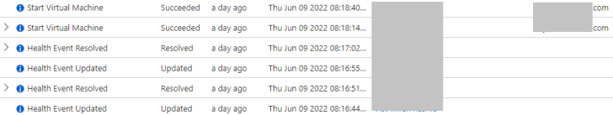
Default Subscription Logs
Activity log events are retained in Azure for 90 days and then deleted
There's no charge for entries during this time regardless of volume
For more functionality such as longer retention, you should route the entries to another location based on your needs
Notes:
Azure Activity log - Azure Monitor | Microsoft Docs - https://docs.microsoft.com/azure/azure-monitor/essentials/activity-log
Send the Activity Log to an Azure Storage Account if you want to retain your log data longer than 90 days for audit, static analysis, or backup. If you only must retain your events for 90 days or less you don't need to set up archival to a Storage Account, since Activity Log events are retained in the Azure platform for 90 days.
Activity log events are retained in Azure for 90 days and then deleted. There's no charge for entries during this time regardless of volume. For more functionality such as longer retention, you should create a diagnostic setting and route the entries to another location based on your needs. See the criteria in the earlier section of this article.

Slide 33
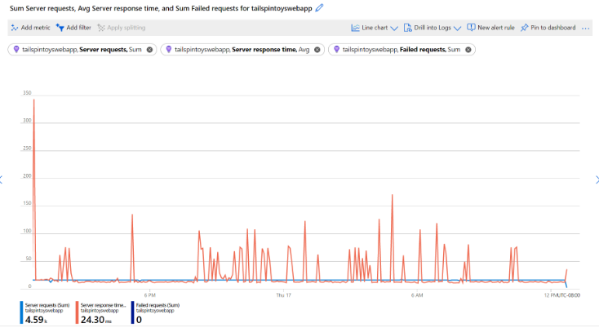
Default Metrics
For most resources in Azure, platform metrics are stored for 93 days at no cost. There are some exceptions.
You can only query (in the Metrics tile) for a maximum of 30 days worth of data on any single chart.
You can send platform metrics for Azure Monitor resources to a Log Analytics workspace for long-term trending.
Notes:
Azure Monitor Metrics is a feature of Azure Monitor that collects numeric data from monitored resources into a time series database. Metrics are numerical values that are collected at regular intervals and describe some aspect of a system at a particular time.
Metrics in Azure Monitor - Azure Monitor | Microsoft Docs - https://docs.microsoft.com/azure/azure-monitor/essentials/data-platform-metrics
Metrics in Azure Monitor are lightweight and capable of supporting near real-time scenarios, so they're useful for alerting and fast detection of issues. You can analyse them interactively by using Metrics Explorer, be proactively notified with an alert when a value crosses a threshold or visualize them in a workbook or dashboard.
For most resources in Azure, platform metrics are stored for 93 days. There are some exceptions:

Slide 34
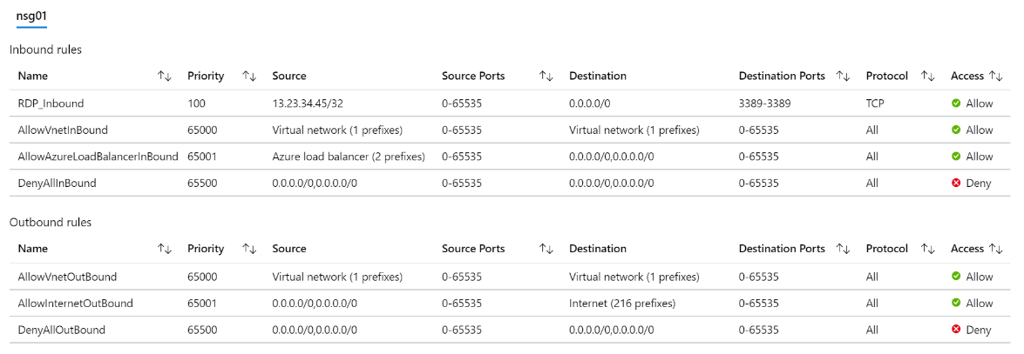
Diagnostics – Effective Security Rules
Details the Effective Security Rules (inbound and outbound) of the Network Interface card of a Virtual Machine
Notes:
Introduction to Effective security rules view in Azure Network Watcher - https://docs.microsoft.com/azure/network-watcher/network-watcher-security-group-view-overview
Student Notes
If you have several NSGs and are not sure which security rules are being applied, you can examine the Effective security rules.
Priority. A number between 100 and 4096. Rules are processed in priority order, with lower numbers processed before higher numbers, because lower numbers have higher priority. Once traffic matches a rule, processing stops. As a result, any rules that exist with lower priorities (higher numbers) that have the same attributes as rules with higher priorities are not processed.
Source. Any, or an individual IP address, classless inter-domain routing (CIDR) block (10.0.0.0/24, for example), service tag, or application security group. Specifying a range, a service tag, or application security group, enables you to create fewer security rules.
Protocol. TCP, UDP, ICMP or Any.
Action. Allow or deny.

Slide 35
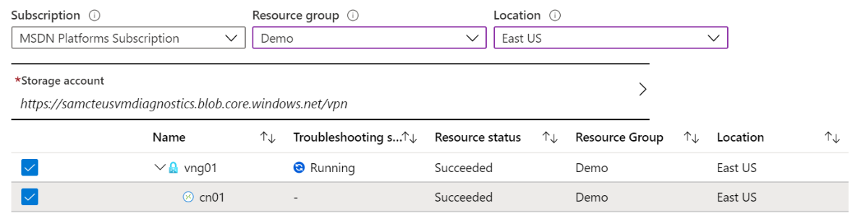
Diagnostics – VPN Troubleshoot
Helps you troubleshoot gateways and connections
Provides summary information and detailed information
Can troubleshoot multiple gateways or connections simultaneously
Notes:
Introduction to resource troubleshooting in Azure Network Watcher - https://docs.microsoft.com/azure/network-watcher/network-watcher-troubleshoot-overview
Student Notes
Virtual Network Gateways provide connectivity between on-premises resources and other virtual networks within Azure. Monitoring gateways and their connections are critical to ensuring communication is working as expected. VPN diagnostics can troubleshoot the health of the gateway, or connection, and provide detailed logging. The request is a long running transaction and results are returned once the diagnosis is complete.
VPN Troubleshoot returns a wealth of information. Summary information is available in the portal and more detailed information is provided in log files. The log files are stored in a storage account and include things like connection statistics, CPU and memory information, IKE security errors, packet drops, and buffers and events.
You can select multiple gateways or connections to troubleshoot simultaneously, or you can focus on an individual component.

Slide 36
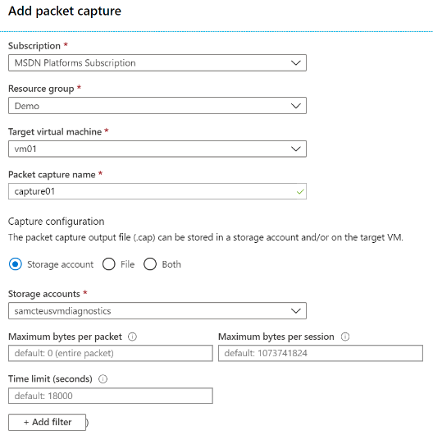
Diagnostics – Packet Capture
Captures inbound and outbound traffic from a Virtual Machine
Saves data to a storage account, a local file, or both
Notes:
Introduction to variable packet capture in Azure Network Watcher - https://docs.microsoft.com/azure/network-watcher/network-watcher-packet-capture-overview
Network Watcher packet capture allows you to create capture sessions to track traffic to and from a virtual machine. Filters are provided for the capture session to ensure you capture only the traffic you want. Packet capture helps to diagnose network anomalies, both reactively, and proactively. Other uses include gathering network statistics, gaining information on network intrusions, to debug client-server communication, and much more. Being able to remotely trigger packet captures, eases the burden of running a packet capture manually on a desired virtual machine, which saves valuable time.

Slide 37
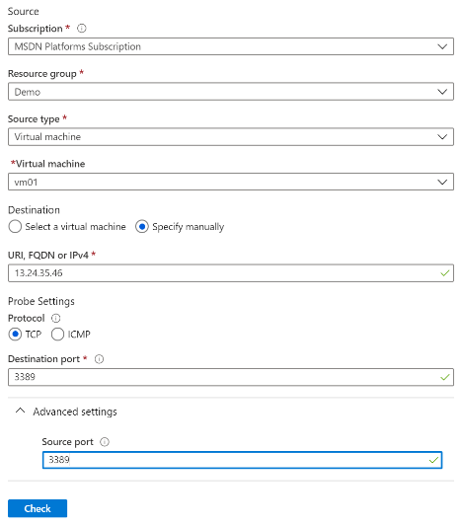
Diagnostics – Connection Troubleshoot
Check connectivity between source VM and destination
Identify configuration issues that are impacting reachability
Provide all possible hop by hop paths from the source to destination
Review hop by hop latency – min, max, and average between source and destination
View a graphical topology from your source to destination
Notes:
Troubleshoot connections with Azure Network Watcher using the Azure portal - https://docs.microsoft.com/azure/network-watcher/network-watcher-connectivity-portal
Student Notes
The connection troubleshoot feature of Network Watcher provides the capability to check a direct TCP connection from a virtual machine to a virtual machine (VM), fully qualified domain name (FQDN), URI, or IPv4 address. Network scenarios are complex, they are implemented using network security groups, firewalls, user-defined routes, and resources provided by Azure. Complex configurations make troubleshooting connectivity issues challenging. Network Watcher helps reduce the amount of time to find and d
Further examples of different supported network troubleshooting scenarios include:
Checking the connectivity and latency to a remote endpoint, such as for websites and storage endpoints.
Connectivity between an Azure VM and an Azure resource like Azure SQL server, where all Azure traffic is tunneled through an on-premises network.
Connectivity between VMs in different VNets connected using VNet peering.
Detect connectivity issues. The results returned can provide insights into whether a connectivity issue is due to a platform or a user configuration issue.

Slide 38
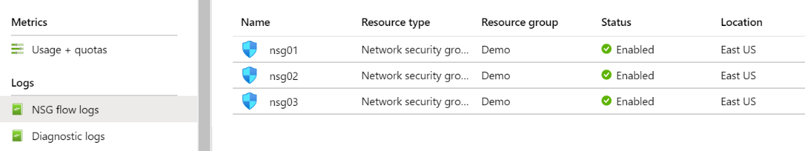
Logs – NSG Flow Logs
View information about ingress and egress IP traffic through an NSG
Flow logs are written in JSON format and show outbound and inbound flows on a per rule basis
The JSON format can be visually displayed in Power BI or third-party tools like Kibana
Notes:
Introduction to flow logging for network security groups - https://docs.microsoft.com/azure/network-watcher/network-watcher-nsg-flow-logging-overview
NSG Flow Logs allow you to view information about ingress and egress IP traffic through an NSG. Flow logs are written in JSON format and show outbound and inbound flows on a per rule basis. The JSON format can be visually displayed in Power BI or third-party tools like Kibana. This feature supports firewalled storage accounts and storage service endpoints.

Slide 39
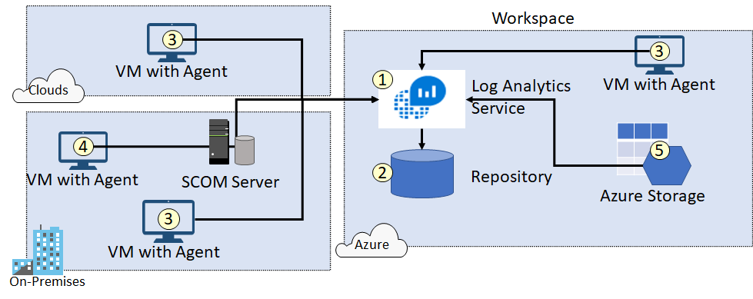
Create Connected Sources
Connected Sources generate data
Data can be collected from Windows, Linux, SCOM and Azure Storage

Slide 40
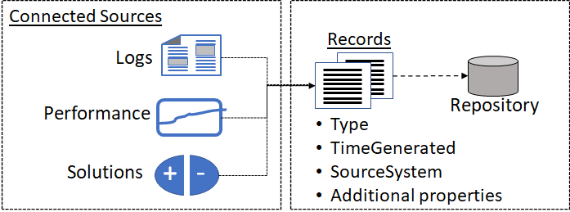
Define Data Sources
Data sources include Windows Event Logs, Windows Performance Counters, Linux Performance Counters, IIS Logs, Custom Fields, Custom Logs, and Syslog
Each data source has additional configuration options
Notes:
Agent data sources in Azure Monitor - https://docs.microsoft.com/en-us/azure/azure-monitor/platform/agent-data-sources

